Slide 1

Title:
Content Delivery Networks (CDNs) and Their Role in Cloud Services
Name : P.B.VAMSI KRISHNA
Regno : 192525147
Course code : csa1415

Slide 2
Objectives:
The objective is to understand CDN architecture, performance optimization, its role in cloud services, and its real-world applications in popular web platforms.

Slide 3
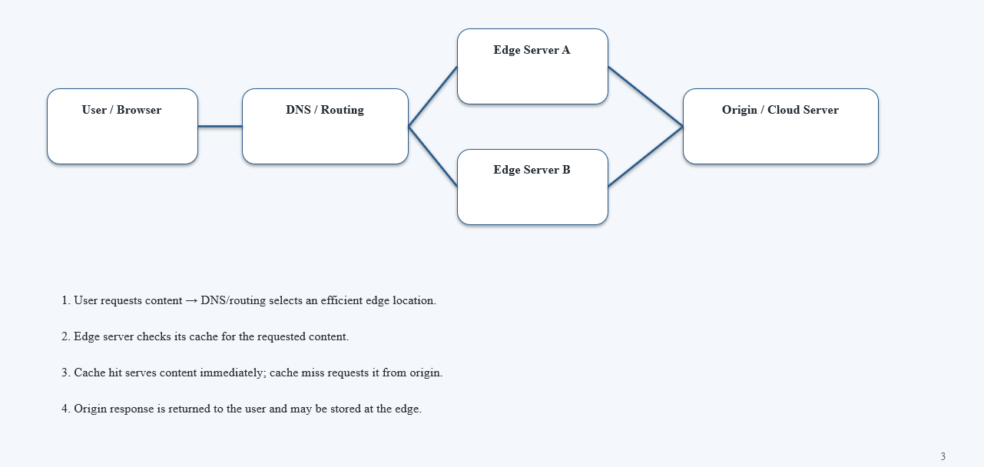
Architecture Diagram

Slide 4
Core Technical Explanation
CDN is a distributed network of servers.
It stores frequently accessed content in cached copies.
Users receive data from the nearest CDN server.
It reduces latency and server load.
Popular CDN providers include Cloudflare, Amazon CloudFront, and Akamai.

Slide 5
Real-World Use Cases & Industry Applications
YouTube uses CDN technology to deliver videos efficiently.
Netflix uses distributed servers for video streaming.
Amazon CloudFront delivers websites and applications globally.
Cloudflare improves speed and provides security.
CDNs help handle millions of users simultaneously.

Slide 6
Conclusion
CDNs make content delivery faster.
They reduce network latency.
They decrease the load on origin servers.
They improve availability and scalability.
Key takeaway: CDNs are essential for fast, reliable, and scalable cloud-based services.

Slide 7


